Slide 1

Digital Electronics and Computer Architecture
SCHOOL OF COMPUTER ENGINEERING AND TECHNOLOGY

Slide 2

Digital Electronics and Computer Architecture
Examination scheme: Total Marks-150
- 60 Marks Class Continuous Assessment
- 50 Marks Laboratory Continuous Assessment
- 40 Marks End Examination

Slide 3
Digital Electronics and Computer Architecture
Course Objectives:
By participating in and understanding all facets of this Course a student will be able:
To learn number systems, Boolean algebra and to introduce the concepts of digital logic families.
To develop skills for design and implementation of combinational logic circuits.
To develop skills for design and implementation of sequential circuits
To understand the functions, characteristics of various components of computer, instruction set, addressing mode of computer architecture and Pipeline Hazards
To acquire the knowledge of Control unit architecture and Memory Organization

Slide 4

Digital Electronics and Computer Architecture
Course Outcomes:
On completion of course, students will be able to
Identify and use the basic logic gates and solve logic equations with various reduction techniques of digital logic circuits.
Design and implement combinational logic circuits
Design and implement sequential logic circuits
Recognize the functions and organization of various blocks of CPU. Describe CPU instruction characteristics used in Pipelining concept and its relevance with Processor’s performance.
Demonstrate computer architecture concepts related control unit and memory

Slide 5

Syllabus
Module 1 Computer Arithmetic:
Introduction to digital logic families, Introduction to Number System and Codes, Sign Magnitude representation, 1’s and 2’s complement, Binary Arithmetic: Addition, Subtraction of signed numbers, multiplication of positive numbers, Integer Arithmetic, Floating point representation and operations – IEEE standard, Boolean Algebra, Logic Gates, Minimization of logic functions using K map (SOP and POS)
Module 2 Combinational Logic Design:
Design examples: Arithmetic circuits, Comparator, Code converters, Parity generators and checkers, Arithmetic and Logic Unit, design of adder and fast adder, look ahead carry generator, Implementation of SOP and POS using MUX, DMUX, DECODER.
Module 3 Sequential Logic Design:
1-bit Memory Cell, Flip flops, Conversion of flip flops, Design of ripple counters and synchronous counters, Modulus of the counter, Sequence generator, Lock out condition. Shift registers, Applications of Shift registers (ring and twisted ring counters), Moore and Mealy Models- State diagram, State Tables and Design Procedure, Sequence detector.

Slide 6
Syllabus
Module 4 Fundamental of Computer Architectures:
Structure and Function, basic operational concepts of bus structures Memory locations and addresses functions. Types of computer units (CPU, Memory, I/O, System Bus), Von Neumann & Harvard architecture, Key characteristics of RISC & CISC.
ALU: Multiplication – Block diagram, Hardware implementation of unsigned binary and signed number, Booth’s Algorithm, Division Algorithms (Unsigned Binary).
Processor organization, Register organization- user visible registers, control and status registers-Case Study 8086. Instruction Cycle- The machine cycle and Data flow. Types of operands, Types of operations, Types of instructions, Addressing modes and Instruction Formats- instruction length, allocation of bits, variable length instructions instruction formats - Case Study- 8086. Processor and Instruction Pipelining, Pipeline Performance, Pipeline Hazards - Structural, Data, Control.

Slide 7
Syllabus
Module 5 Control Unit and Memory System:
Hardwired control, Micro-programmed control- micro instructions, micro-program sequencing, wide branch addressing, microinstruction with next address field, prefetching microinstructions and emulation.
Memory hierarchy, characteristics, Cache Memory- Cache memory principles, Elements of cache design- cache address, size, mapping functions, replacement algorithms, write policy, line size, number of cache, one level and two level cache, performance characteristics of two level cache- locality & operations, main memory and secondary storage. Pentium IV cache organization

Slide 8
Syllabus
List of Assignments:
Design and Implement Code Converters using logic gates
Design and Implement Combinational Logic Design using MUX/Decoder ICs
Design and Implement asynchronous counter using JK- Flip flop.
Design and Implement MOD-N asynchronous counter using JK- Flip flop /IC7490.
Design and implement Synchronous Counter
Design of a sequence detector
Write an assembly language program (ALP) to display 2-digit and 4-digit hex numbers using 64- bit assembly language programming
Write an assembly language program (ALP) to accept 2-digit and 4-digit hex numbers user input using 64- bit assembly language programming.
Write an assembly language program (ALP) to implement addition and subtraction of 8-bit numbers (Using user input, macro and procedure).
Write an ALP to perform basic string operations. (length and Reverse)

Slide 9
Module 1 Computer Arithmetic
Introduction to digital logic families,
Introduction to Number System and Codes,
Sign Magnitude representation, 1’s and 2’s complement,
Binary Arithmetic: Addition, Subtraction of signed numbers, multiplication of positive numbers, Integer Arithmetic,
Floating point representation and operations – IEEE standard, Boolean Algebra, Logic Gates, Minimization of logic functions using K map (SOP and POS)

Slide 10
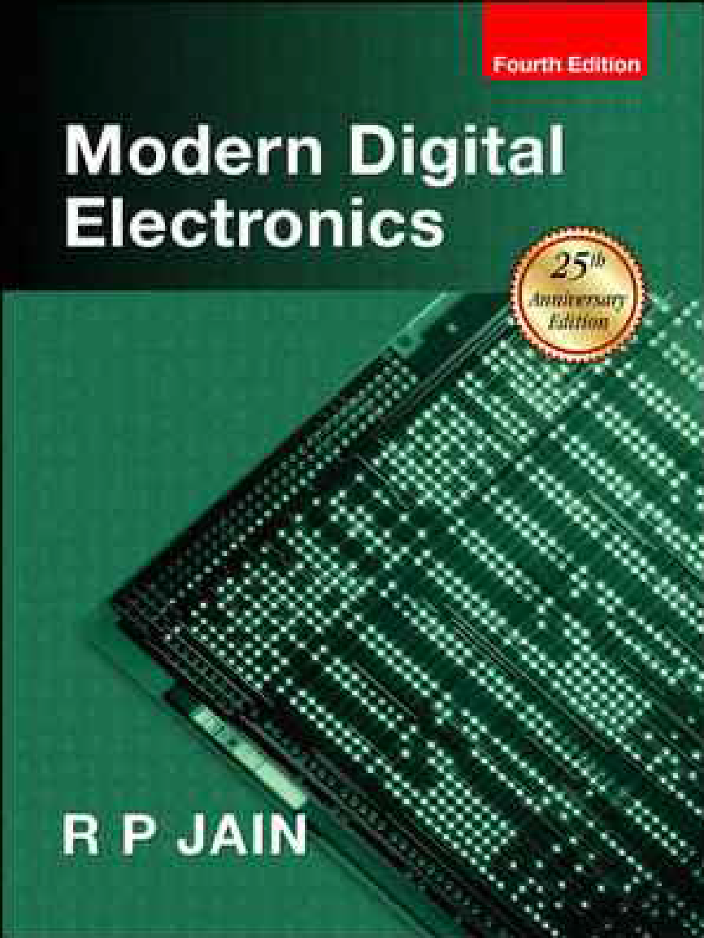
Text book soft copy available

Slide 11
Digital and Analog Quantities
For many years, applications of digital electronics were limited to computer systems.
Digital Technology have wide range of applications
Television
Communication systems
Radar
Navigation
Military Systems
Medical Instrumentations
Industrial Process Control
Consumer electronics etc.
Electronics circuits can be divided into two broad categories
Digital
Analog

Slide 12
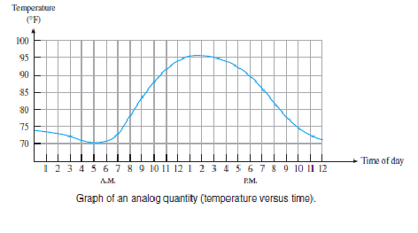
Digital and Analog Quantities
Analog: is one having continuous values
Digital: is one having discrete set of values
Example: Air temperature changes over continuous range of values
Analog Signal

Slide 13
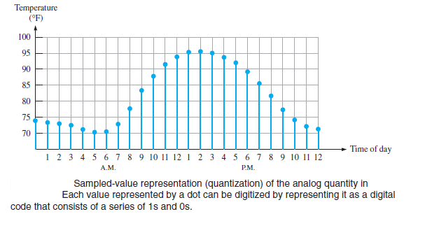
Digital Code

Slide 14
Advantages of Digital Signals
Data transmission is more effective and reliable
Digital data has a great advantage when storage is necessary
Digital data is more accurate and precise
Its ripple free or noise free

Slide 15
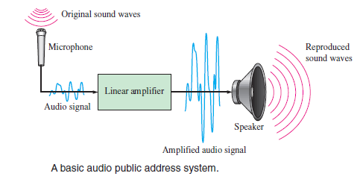
Analog Systems

Slide 16
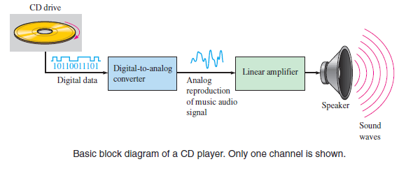
A System Using Anolog and Digital Methods

Slide 17
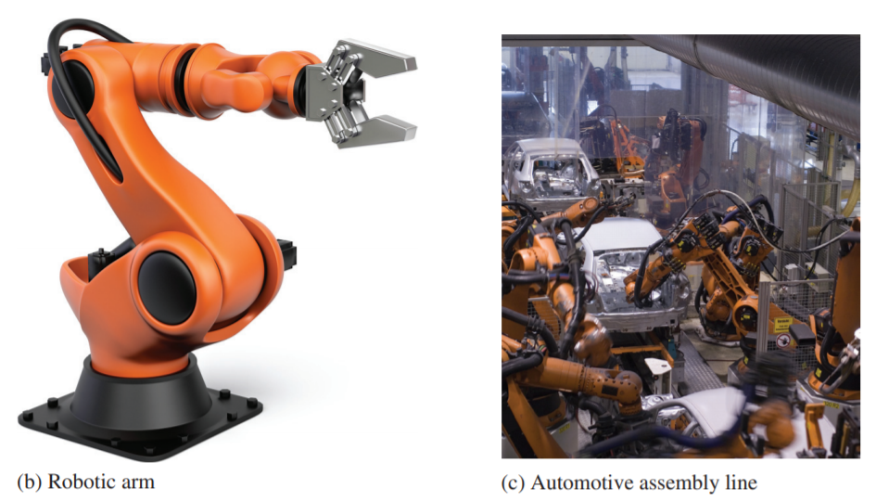
Mechatronics
The interdisciplinary field that comprises both mechanical and electronic components is known as mechatronics
Both digital and analog electronics are used in the control of various mechanical systems.

Slide 18
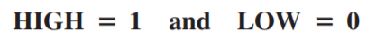
Digital Electronics
It uses Binary Digits 0 and 1
Each of the two digits in the binary system, 1 and 0, is called a bit, Two different voltage levels are used to represent the two bits.
1 - is represented by the higher voltage, which will be referred as a HIGH,
0 - is represented by the lower voltage level, which will be referred as a LOW.
This is called positive logic and will be used throughout the topic.

Slide 19
Logic Families

Slide 20
Introduction
What is logic families?
It is a group of compatible ICs with the same logic levels & supply voltages for performing various logic functions have been fabricated using a specific circuit configuration
Significance of logic families
First and most important is simplicity in design
It reduces the complexity in design
Provide compatibility in digital circuit
Easy to expand

Slide 21
Classification of Logic Families
Logic Families
Unipolar
Bipolar
PMOS
NMOS
CMOS
Saturated
Non Saturated
RTL
DTL
TTL
Schottkey TTL
ECL

Slide 22
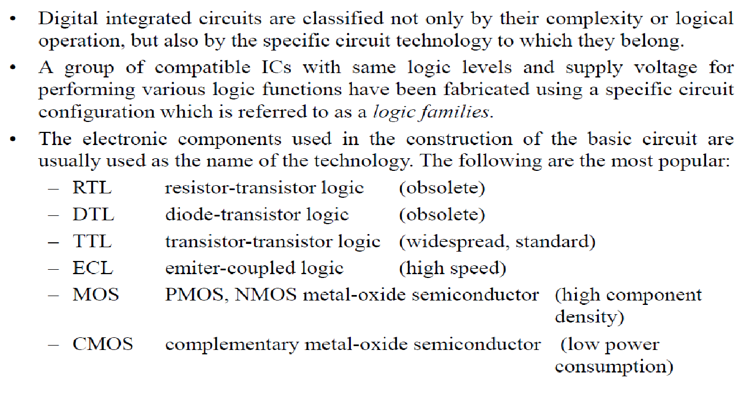
Digital Logic Families

Slide 23
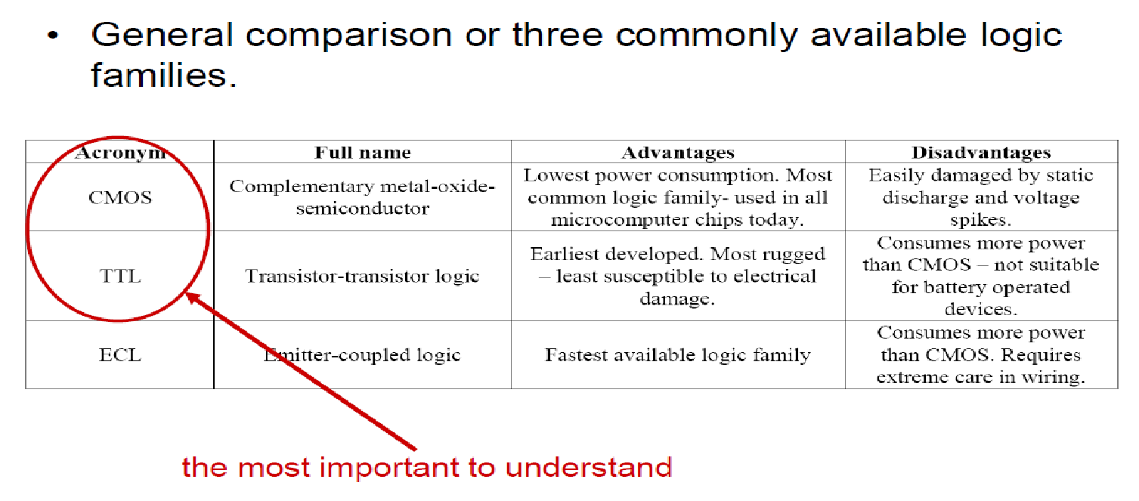
Example Logic Families

Slide 24
Characteristics of Digital ICs
Speed of Operation
Power Dissipation
Figure of Merit
Fan Out
Fan In
Current and Voltage Parameters
Noise Immunity
Power Supply Requirements
Operating Temperature

Slide 25
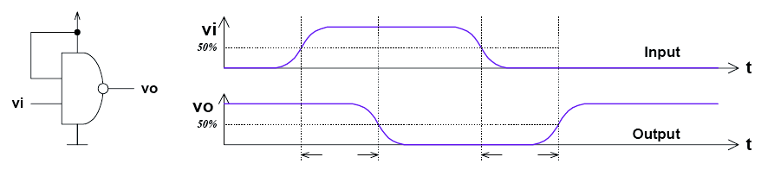
Characteristics of Digital ICs
Speed of Operation/ Propagation Delay time
TPD,HL–input-to-output propagation delay from HI to LO output TPD,LH–input-to-output propagation delay from LO to HI output
Propagation delay is average of TPD, HL and TPD, LH
T_{pHL}
T_{pLH}

Slide 26
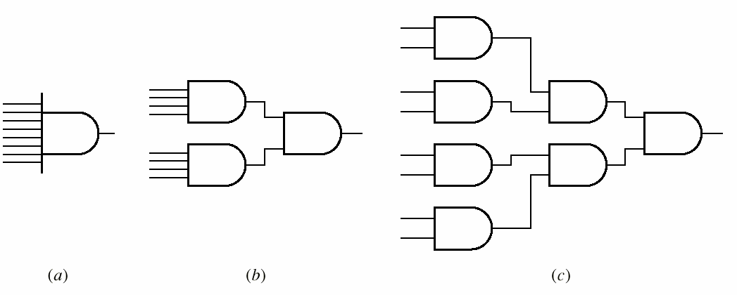
Characteristics of Digital ICs Propagation Delay
Propagation Delay - Causes
Time to switch the transistor
Time to charge or discharge the load capacitance

Slide 27
Characteristics of Digital ICs
Power Dissipation
It is wastage (dissipation) of power across the circuit components.
It should be as low as possible.
It is measured in milliwatts

Slide 28
Characteristics of Digital ICs
Figure of Merit (Speed of operation)
Figure of Merit = Propagation Delay (ns) * Power Dissipation (mw) in pj
ns – nano seconds
mw – milliwatts
pj – pico joules
Speed-power product: TPD ×Pavg

Slide 29
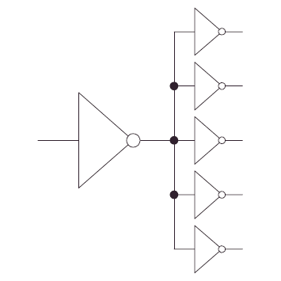
Characteristics of Digital ICs
Fan Out
It is capability of a logic gate to drive maximum no. of similar gates.
High fan out is desirable
Fan In
It is total no. of inputs connected to any gate.
Two input gate – Fan in =2
Four input gate – Fan in =4

Slide 30
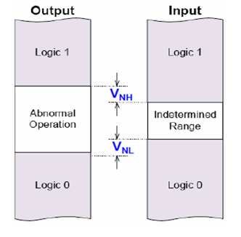
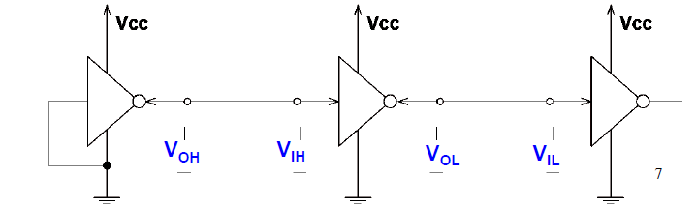
Characteristics of Digital ICs
Voltage Parameters
VOH(min) –The minimum voltage level at an output in the logical “1” state under defined load conditions
VOL(max) –The maximum voltage level at an output in the logical “0” state under defined load conditions
VIH(min) –The minimum voltage required at an input to be recognized as “1” logical state
VIL(max) –The maximum voltage required at an input that still will be recognized as “0” logical state

Slide 31
Number System and Binary Codes

Slide 32
Number System and Binary Codes
Number systems
Representation of unsigned and signed integers
Fixed-point representation of real numbers
Floating-point representation of real numbers
Binary representation
Codes and their conversions
Binary arithmetic

Slide 33
Number Systems
Decimal
1234₁₀ = (1 × 10³) + (2 × 10²) + (3 × 10¹) + (4 × 10⁰)
Binary
1101₂ = (1 × 2³) + (1 × 2²) + (0 × 2¹) + (1 × 2⁰)
Octal
123₈ = (1 × 8³) + (2 × 8²) + (3 × 8¹)
Hexadecimal
123₁₆ = (1 × 16³) + (2 × 16²) + (3 × 16¹)
here we need 16 characters – 0,1,2,3,4,5,6,7,8,9,A,B,C,D,E,F

Slide 34
Binary number into Decimal
Convert the given binary number into decimal equivalent number
(100010)₂=0×2⁰+1×2¹+0×2²+0×2³+0×2⁴+1×2⁵
=0+2+0+0+0+32
=(34)₁₀
2. (0.1011)₂=1×2⁻¹+0×2⁻²+1×2⁻³+1×2⁻⁴
=0.5+0+0.125+0.0625
=(0.6875)₁₀
3. (10101.011)₂
Integer part: (10101)₂=1×2⁰+0×2¹+1×2²+0×2³+1×2⁴
=1+0+4+0+16 = (21)₁₀
Decimal part: (0.011)₂=0×2⁻¹+1×2⁻²+1×2⁻³
= (0.375)₁₀
= (21.375)₁₀

Slide 35
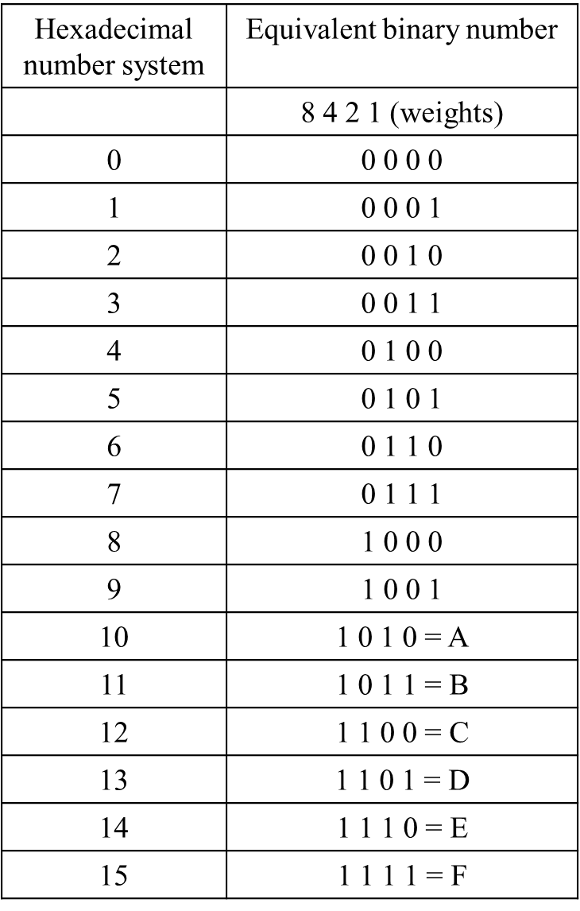
Hexadecimal Number System
Hexadecimal Number System:
The hexadecimal number system has base 16. It has 16 distinct digit symbols. It uses the digits 0-9 & letters A,B,C,D,E,F as 16 digit symbols.
Hexadecimal to Binary Conversion
Hexadecimal C 3
Binary 1100 0011
Binary to Hexadecimal Conversion
Binary 1110 1010
Hexadecimal E A

Slide 36
Hexadecimal Number System
DECIMAL TO HEXADECIMAL CONVERSION
Divide by 16 Process
Decimal #
47 ÷ 16 = 2 remainder 15
2 ÷ 16 = 0 remainder 2
2 F
HEXADECIMAL NUMBER INTO DECIMAL NUMBER SYSTEM
1. (2B8D.E2)16= 2×16³+11×16²+8×16¹+13×16⁰ +14×16⁻¹+2×16⁻²
= 8192+2816+128+13+0.875+0.0078125
= (11149.88281)₁₀
(269)₁₆= ? Answer: (617)₁₀

Slide 37
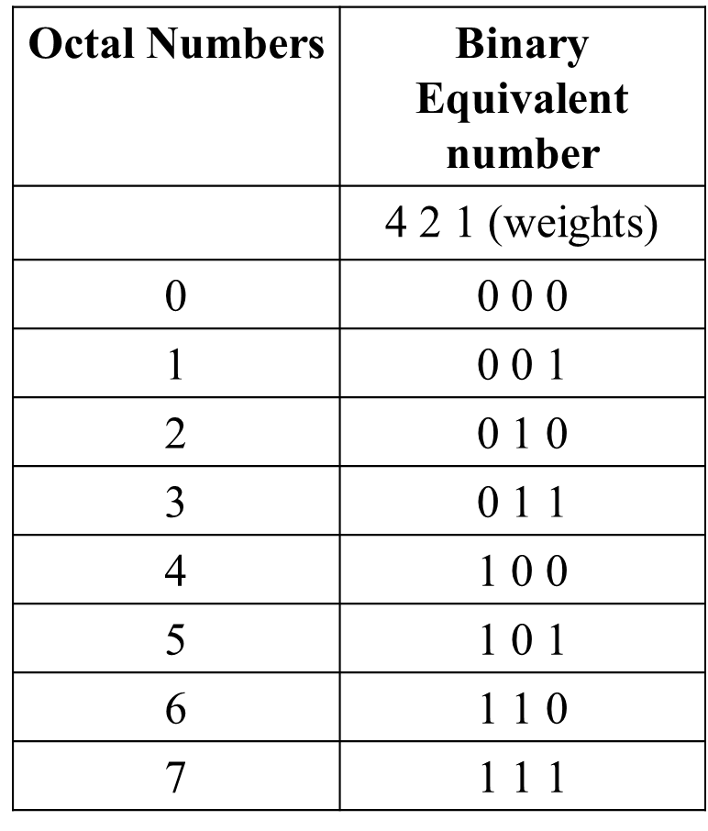
Octal Number System
A number system that uses 8 digit (0-7) is
called an octal number system. It has base 8.
Octal number system into Binary number system:
(7423.245)₈
7 | 4 | 2 | 3 | . | 2 | 4 | 5
111 | 100 | 010 | 011 | . | 010 | 100 | 101
Conversion from Binary number system to Octal number system:
(11101101110.11111)₂
011 | 101 | 101 | 110 | . | 111 | 110
3 | 5 | 5 | 6 | . | 7 | 6

Slide 38
Octal Number System
Octal to Decimal Conversion
Multiplying each Octal digit by its positional weight
(314)₈ = 3×8³+3×8²+1×8¹+4×8⁰ = 192 + 8 + 4
= (204)₁₀
Decimal to Octal Conversion
Repeated division or double dabble method
(1375)₁₀ = (2537) ₈
_{remainder}
8 | 1375
8 | 171 | 7
8 | 21 | 3
 | 2 | 5
 |  | 2
MSB

Slide 39

Hexadecimal number system to Octal number system:
First write down the 4 bit binary equivalent of hexadecimal digit and then rearranging into group of three bit each.
(2AB.9) ₁₆ = (?)₈
Hexadecimal equivalent | 2 A B . 9 0010 1010 1011 . 1001
Octal equivalent | 001 010 101 011 . 100 100 1 2 5 3 . 4 4
Convert (1375) ₈ = ( )₁₆
₁₃₇₅ ₌ ₀₀₁ ₀₁₁ ₁₁₁ ₁₀₁
Now 001011111101 0010 1111 1101
₂ ₁₅ ₁₃
2 F D

Slide 40


TEST
Convert Hexadecimal number A6 to Binary
Convert Hexadecimal number 16 to Decimal
Convert Decimal 63 to Hexadecimal
Convert Decimal 41.915 to Binary
Convert hexadecimal 7FD6 to Octal
1010 0110 (Binary)
3F (Hexadecimal)
101001.11101
77726

Slide 41
Takeaway
Digital computers are implemented via logic circuits and thus represent all numbers in binary (base 2).
We (humans) often write numbers as decimal and hexadecimal for convenience, so need to be able to convert to binary and back (to understand what computer is doing!).

Slide 42
Representation of Unsigned and Signed Integers
Are the negative numbers just numbers with a minus sign in the front? This is probably true…but there are issues to represent negative numbers in computing systems
Common schemas:
Sign-magnitude
Complementary representations:
1’s complement
2’s complement – most common & important

Slide 43
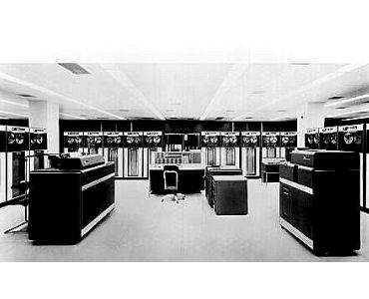
First Attempt: Sign/Magnitude Representation
First Attempt: Sign/Magnitude Representation
1 bit for sign (0=positive, 1=negative)
The sign bit is the left-most bit in a signed binary number
N-1 bits for magnitude
Problem?
Two zero’s: +0 different than -0
Complicated circuits
IBM 7090

Slide 44
Second Attempt: One’s complement
Second Attempt: One’s complement
Leading 0’s for positive and 1’s for negative
Negative numbers: complement the positive number
Problem?
Two zero’s still: +0 different than -0
Complicated circuits
Carry is difficult
0111 = 7
1000 = -7
0000 = +0
1111 = -0

Slide 45
One’s complement
For example, in 8-bit one’s complement,
positive 3 is: 00000011
Negative 3 is: 11111100
In one’s complement, as with signed magnitude, negative values are indicated by a 1 in the high order bit.
Complement systems are useful because they eliminate the need for subtraction. The difference of two values is found by adding the minuend to the complement of the subtrahend.

Slide 46
Two’s Complement Representation
Step 1: First complement all the bits (that is find one’s complement) Make all 1s as 0s and all 0s as 1s
Step 2:Then perform increment by 1 Add 0001 b

Slide 47
Decimal | Signed Magnitude | Ones Complement | Twos Complement
+8 | - | - | -
+7 | 0111 | 0111 | 0111
+6 | 0110 | 0110 | 0110
+5 | 0101 | 0101 | 0101
+4 | 0100 | 0100 | 0100
+3 | 0011 | 0011 | 0011
+2 | 0010 | 0010 | 0010
+1 | 0001 | 0001 | 0001
+0 | 0000 | 0000 | 0000
-0 | 1000 | 1111 | -
-1 | 1001 | 1110 | 1111
-2 | 1010 | 1101 | 1110
-3 | 1011 | 1100 | 1101
-4 | 1100 | 1011 | 1100
-5 | 1101 | 1010 | 1011
-6 | 1110 | 1001 | 1010
-7 | 1111 | 1000 | 1001
-8 | - | - | 1000

Slide 48
Representation of Unsigned and Signed integers
Decimal No. | Unsigned | Sign Magnitude (SNM) | 1s Complement | 2s Complement
+50 | 110010 | 0110010 | 0110010 | 0110010
-50 | XXXXX | 1110010 | 1001101 | 1001110
Write (-60) in 2s complement?
1 0 0 0 1 0 0

Slide 49
Signed Numbers
Range of Values
Total combinations = 2^{n}
2’s complement form:
– (2^{n – 1}) to + (2^{n – 1} – 1)
Range for 8 bit number: n = 8 -(2⁸⁻¹) = -2⁷ = -128 minimum +(2⁸⁻¹) – 1 = +2⁷ - 1 = +127 maximum
Total combination of numbers is 2⁸ = 256.

Slide 50
Floating-Point Representation
The signed magnitude, 1’s complement, and 2’s complement representations are not useful in scientific or business applications that deal with real number values over a wide range.
Floating-point representation solves this problem.
Capable of representing very large and very small numbers without an increase in the number of bits

Slide 51
Signed Numbers
Floating-point numbers
Three Parts
Sign
Mantissa represents magnitude of number
Exponent represents number of places that binary point is to be moved
Three forms (IEEE 754)
Single-precision (32 bits) float
Double-precision (64 bits) double
Extended-precision (80 bits) long double
Also have Quadruple and Quadruple extended!

Slide 52
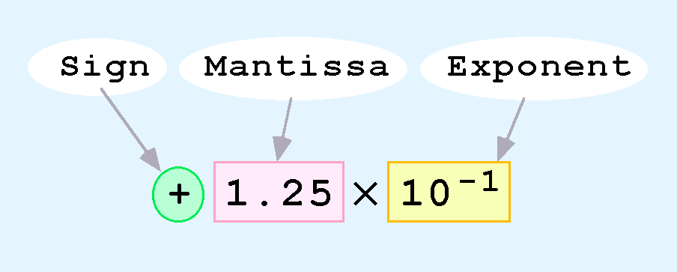
Floating-Point Representation
Computers use a form of scientific notation for floating-point representation
Numbers written in scientific notation have three components:

Slide 53
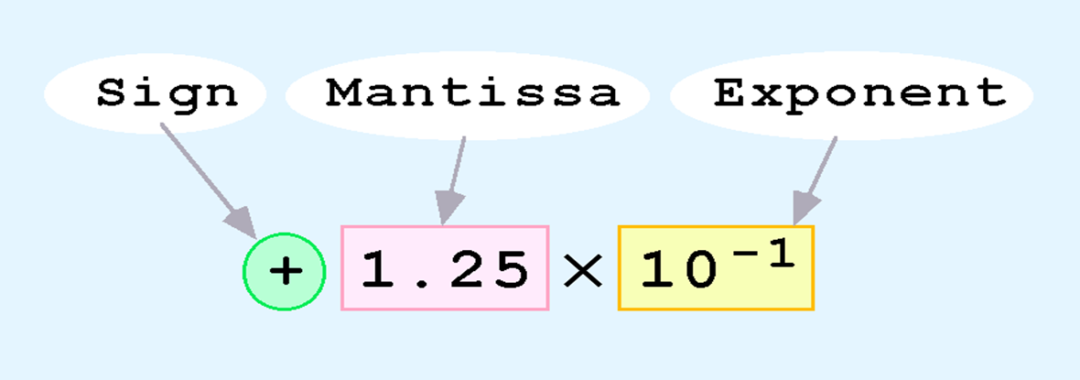
Floating-Point Representation
The one-bit sign field is the sign of the stored value.
The size of the exponent field, determines the range of values that can be represented.
The size of the Mantissa/significand determines the precision of the representation.

Slide 54
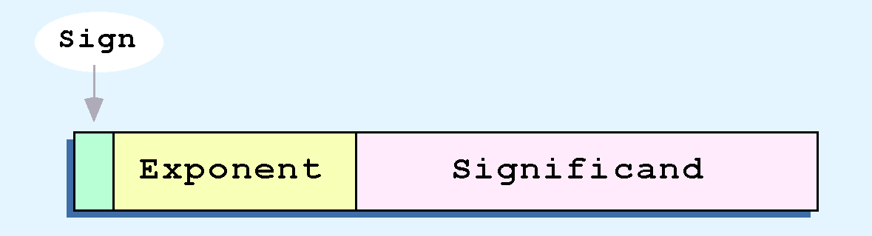
Floating-Point Representation
The IEEE-754 single precision floating point standard uses an 8-bit exponent and a 23-bit Mantissa/significand.
The IEEE-754 double precision standard uses an 11-bit exponent and a 52-bit significand

Slide 55
Single Precision
32 bits
S Exponent (E) Mantissa (fraction, F)
1 bit 8 bits 23 bits
IEEE 754 standard
Mantissa (F) has hidden bit so actually has 24 bits. Gives 7 significant figures.
1st bit in mantissa is always a one
Exponent (E) is biased by 127 called Excess-127 Notation
Add 127 to exponent so easier to compare
Range of exponents is -126 to +128
Sign (S) bit tells whether number is negative or positive

Slide 56
Floating-Point Representation
The significand of a floating-point number is always preceded by an implied binary point.
Thus, the significand always contains a fractional binary value.
The exponent indicates the power of 2 to which the significand is raised.

Slide 57
Single Precision
Example: Convert 5777₁₀ to Floating Point
1st, convert to binary using divide by 2 method
5777₁₀ = 1011010010001₂
Positive number, so sign bit (S) equals 0.
2nd, count number of places to move binary point
1011010010001₂ = 1.011010010001 x 2¹²
Add 127 to 12 = 139₁₀ = 10001011₂
Mantissa is fractional part, 011010010001
Finally, put everything together
S E F
Fill in with trailing zeroes
0 10001011 01101001000100000000000

Slide 58
Ex 1: Find the IEEE FP representation of 40.15625
Step 1.
Compute the binary equivalent of the whole part and the fractional part. (i.e. convert 40 and .15625 to their binary equivalents)
40.15625₁₀ = 101000.00101₂
Step 2.
Normalize the number by moving the decimal point to the right of the leftmost one.
101000.00101 = 1.0100000101 x 2⁵

Slide 59
Step 3.
Convert the exponent to a biased exponent
127 + 5 = 132
And convert biased exponent to 8-bit unsigned binary:
132₁₀ = 10000100₂
Step 4.
Store the results from steps 1-3:
Sign Exponent Mantissa
(from step 3) (from step 2)
0 10000100 01000001010000000000000

Slide 60
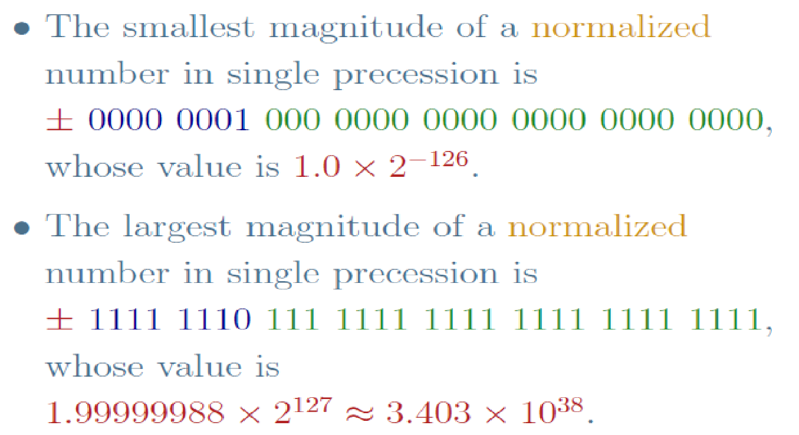

Slide 61

Ex 2: Find the IEEE FP representation of –24.75
1 10000011 1000110..0

Slide 62
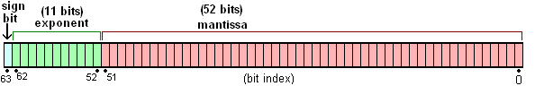
Double Precision
Exponent has 11 bits so uses Excess-1023 Notation
Mantissa has 53 bits (one hidden)
53 bits gives 16 significant figures

Slide 63
IEEE standard to Decimal Floating Point Conversion.
Ex 1: Convert the following 32-bit binary number to its decimal floating point equivalent:
Sign Exponent Mantissa
1 01111101 010..0

Slide 64
IEEE standard to Decimal Floating Point Conversion..
Step 1: Extract the biased exponent and unbias it
Biased exponent = 01111101₂ = 125₁₀
Unbiased Exponent: 125 – 127 = -2

Slide 65
IEEE standard to Decimal Floating Point Conversion..
Step 2: Write Normalized number in the form:
1 . ____________ x 2 ⁻⁻⁻⁻
For our number:
-1. 01 x 2 ^{–2}
Mantissa
Exponent

Slide 66
IEEE standard to Decimal Floating Point Conversion.
Step 3: Denormalize the binary number from step 2 (i.e. move the decimal and get rid of (x 2^{n}) part):
-0.0101₂ (negative exponent – move left)
Step 4: Convert binary number to the FP equivalent (i.e. Add all column values with 1s in them)
-0.0101₂ = - ( 0.25 + 0.0625)
= -0.3125₁₀

Slide 67
IEEE standard to Decimal Floating Point Conversion.
Ex 2: Convert the following 32 bit binary number to its decimal floating point equivalent:
Sign Exponent Mantissa
0 10000011 10011000..0

Slide 68
Special Cases
Zero and infinity are special cases
Can have +0 or -0 depending on sign bit
Can also have +∞ or ⁻∞
Not a Number (NaN)
if underflow or overflow
Type | Exponent | Mantissa
Zeroes | 0 | 0
Denormalized numbers | 0 | non zero
Normalized numbers | 1-254 | anything
Infinities | 255 | 0
NaNs | 255 | non zero

Slide 69
Examples
Type | Exponent | Mantissa | Value
Zero | 0000 0000 | 000 0000 0000 0000 0000 0000 | 0.0
One | 0111 1111 | 000 0000 0000 0000 0000 0000 | 1.0
Denormalized number | 0000 0000 | 100 0000 0000 0000 0000 0000 | 5.9×10⁻³⁹
Large normalized number | 1111 1110 | 111 1111 1111 1111 1111 1111 | 3.4×10³⁸
Small normalized number | 0000 0001 | 000 0000 0000 0000 0000 0000 | 1.18×10⁻³⁸
Infinity | 1111 1111 | 000 0000 0000 0000 0000 0000 | Infinity
NaN | 1111 1111 | 010 0000 0000 0000 0000 0000 | NaN

Slide 70
WHAT IS A BINARY CODE ?
In the coding, when numbers, letters or words are represented by a specific group of symbols, it is said that the number, letter or word is being encoded.
The group of symbols is called as a code. The digital data is represented, stored and transmitted as group of binary bits. This group is also called as binary code. The binary code is represented by the number as well as alphanumeric letter.

Slide 71
Classification of Binary Codes
Weighted Codes
Non-Weighted Codes
Binary Coded Decimal Code
Alphanumeric Codes
Error Detecting Codes
Error Correcting Codes

Slide 72
2421 CODE
This code has the advantage that it is self-complementing, that is, the code word for the 9s’ complement of any digit may be obtained by complementing the individual bits of the digit’s code word.
0010 = 2
9s’complement of 2 can be obtained by complementing individual bits
1101 = (2+4+0+1) = 7

Slide 73
Codes and their conversions
Gray Code
Gray code is a code where only one bit changes at a time while traversing from 0 to any decimal number in sequence.
Gray Code is nonweighted and cyclic code
Not arithmetic code
Optical shaft encoders for disk to reduce errors

Slide 74
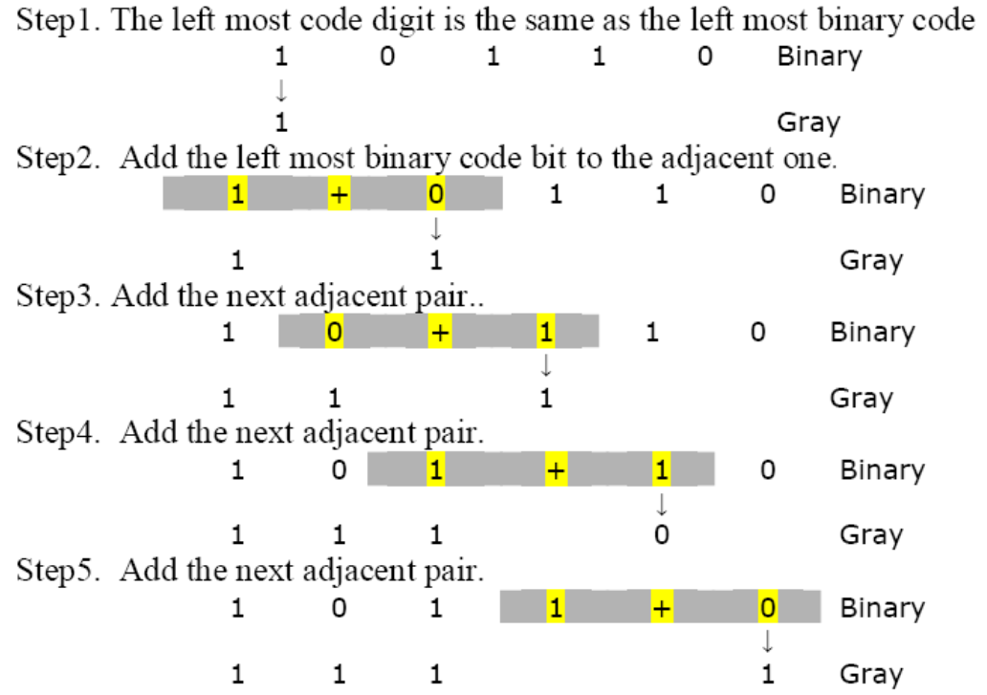
Binary to Gray Code Conversion

Slide 75
Gary to Binary Code Conversion
MSB of binary is set to the MSB of Gray code
Going from left to right, add the binary bit to the next Gray code bit. Discard carries.
Example. Convert 11011 to binary
MSB of Gray Code is 1, so set the MSB of the binary number to 1.
1 1 0 1 1 Gray Code
+
+
+
+
1 Binary
0
0
1
0

Slide 76
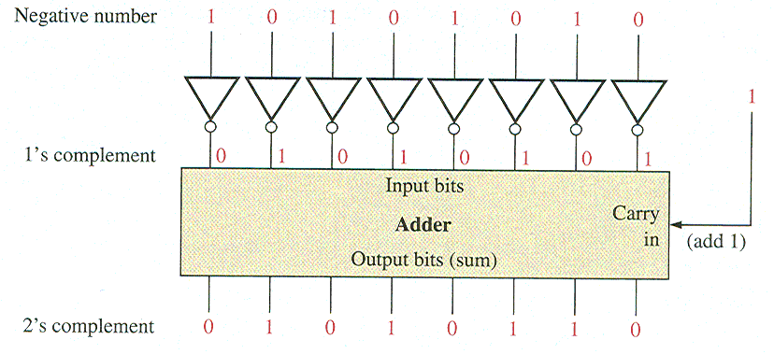
Binary arithmetic
Complements of Binary Numbers

Slide 77
Binary arithmetic
Binary Addition
The rules for binary addition are
0 + 0 = 0 Sum = 0, carry out = 0
0 + 1 = 1 Sum = 1, carry out = 0
1 + 0 = 1 Sum = 1, carry out = 0
1 + 1 = 10 Sum = 0, carry out = 1
When a carry in = 1 due to a previous result, the rules are
1 + 0 + 0 = 01 Sum = 1, carry out = 0
1 + 0 + 1 = 10 Sum = 0, carry out = 1
1 + 1 + 0 = 10 Sum = 0, carry out = 1
1 + 1 + 1 = 11 Sum = 1, carry out = 1
Notes:
-Recall learning addition & subtraction rules as a kid (346+243; 155+197).
-Binary is similar, but with far fewer possible combinations of 1-digit numbers.
-First, 4 flashcards with no carry; then 4 with carry=0 and 4 with carry=1.

Slide 78
Binary Addition
Example
Add the binary numbers 00111 and 10101 and show the equivalent decimal addition.
Solution
0
1
1
1
00111 7
10101 21
1
1
1
0
0
=
28
Notes:
Do Practice Question 1.

Slide 79
Terminology: One’s-Complement and Two’s-Complement
The one’s-complement of a binary number is the binary number that you get when you invert each bit.
Example: What is the one’s-complement of 10101010?
The two’s-complement of a binary number is the binary number that you get when you invert each bit and then add 1 to the result.
Example: What is the two’s-complement of 10101010?
Notes:
‹#›
Do Practice Questions 4 and 5.

Slide 80
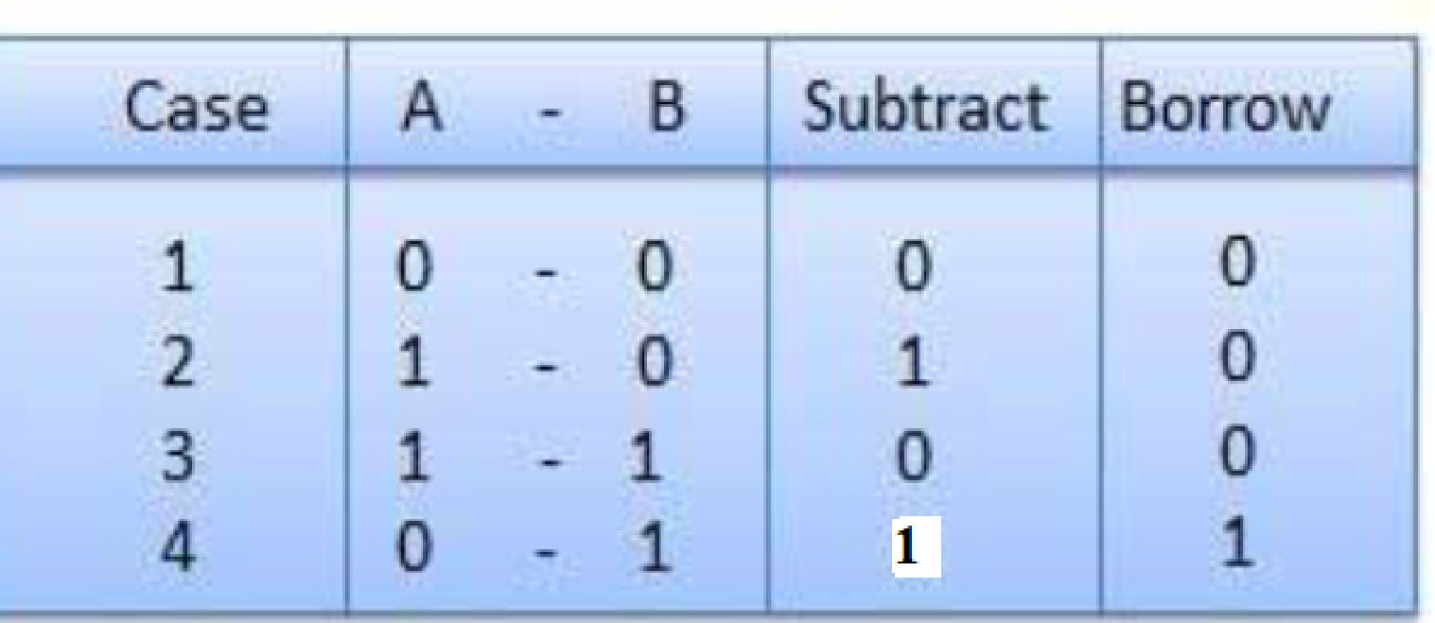
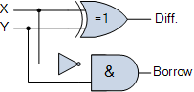
Binary Subtraction
Symbol | Truth Table
 | Y | X | DIFFERENCE | BORROW
 | 0 | 0 | 0 | 0
 | 0 | 1 | 1 | 0
 | 1 | 0 | 1 | 1
 | 1 | 1 | 0 | 0

Slide 81
Binary Subtraction
To do binary subtraction by hand, you can memorize rules similar to the rules for addition. But this can be a bit tricky because of the need to borrow in some cases.
A better way: Negate the subtrahend, and then add to the minuend.
This should be a familiar idea, since you know that subtracting 12 minus 5 is the same as adding 12 plus -5.
So instead of needing new rules for subtraction, you just need to combine two earlier skills:
Negate a number (by taking its 2’s-complement).
Add binary numbers.
Notes:
‹#›

Slide 82
The steps to be followed in subtraction by 1’s complement are:
i) To write down 1’s complement of the subtrahend.
ii) To add this with the minuend.
iii) If the result of addition has a carry over then it is dropped and an 1 is added in the last bit.
iv) If there is no carry over, then 1’s complement of the result of addition is obtained to get the final result and it is negative.
Evaluate:(i) 110101 – 100101
Solution:
1’s complement of 100101 is 011010. Hence
Minued - 1 1 0 1 0 1 1’s complement of subtrahend - 0 1 1 0 1 0 Carry over - 1 0 0 1 1 1 1 1 0 1 0 0 0 0

Slide 83
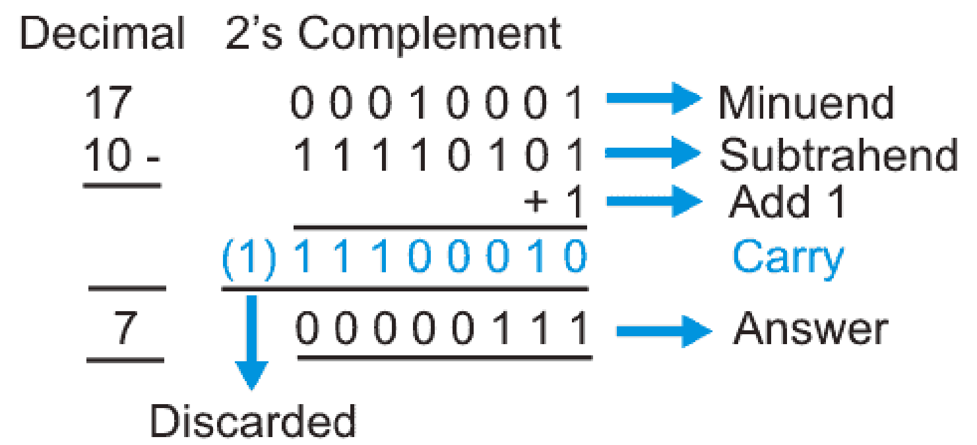
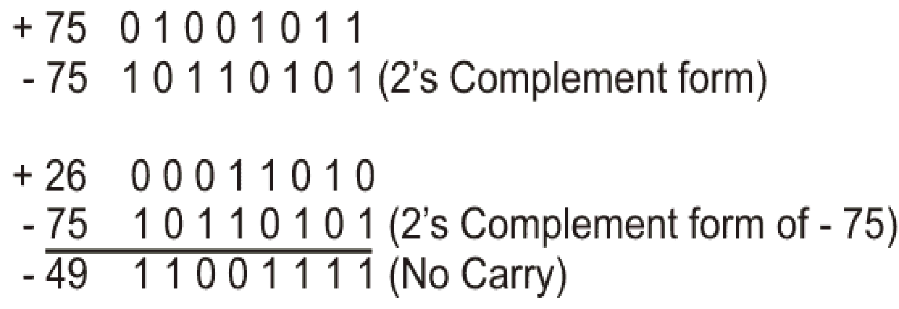
Binary Subtraction Rule using 2s Complement
M is Minuend and N is subtrahend. Then, subtraction (M – N) can be performed using twos complement method described as follows
1. Find 2’s complement of the subtrahend.
2. Add the Minuend and 2’s complement of the subtrahend.
3. If carry generated in step 2 then discard the carry, keep the result which will be answer for subtraction and the result will be positive.
4. If no carry is generated, in step 2 then find the 2’s complement of the result and the result will be negative.
- 00110001

Slide 84
Overflow
Overflow is a problem that can arise in arithmetic circuits that perform two’s-complement addition and subtraction.
This occurs when the result falls outside the range of values that can be represented using the number of bits available.
Notes:
‹#›

Slide 85
Overflow: Example
Suppose we’re using 8-bit two’s-complement notation and we try to add 120 + 15. We know the result should be 135, but the maximum number we can represent in 8-bit two’s-complement notation is 127.
In binary, it looks like this:
0111 1000 120
+ 0000 1111 + 15
1000 0111
-121 ?!?! Wrong!
It’s obvious from the sign bits that something went wrong here because we’re adding two
positive numbers but we got a negative result.
Notes:
‹#›

Slide 86
Detecting Overflow
There are a few ways to determine whether a 2’s-complement computation has resulted in an overflow.
Probably the most widely used is: if there’s a carry into the sign bit but no carry out of the sign bit (or vice versa), then overflow has occurred and the result cannot be trusted.
0111 1000 120
+ 0000 1111 + 15
1000 0111
-121 ?!?! Wrong!
In our previous example, note that there is a carry into the sign bit but no carry out of the sign bit.
Notes:
‹#›

Slide 87
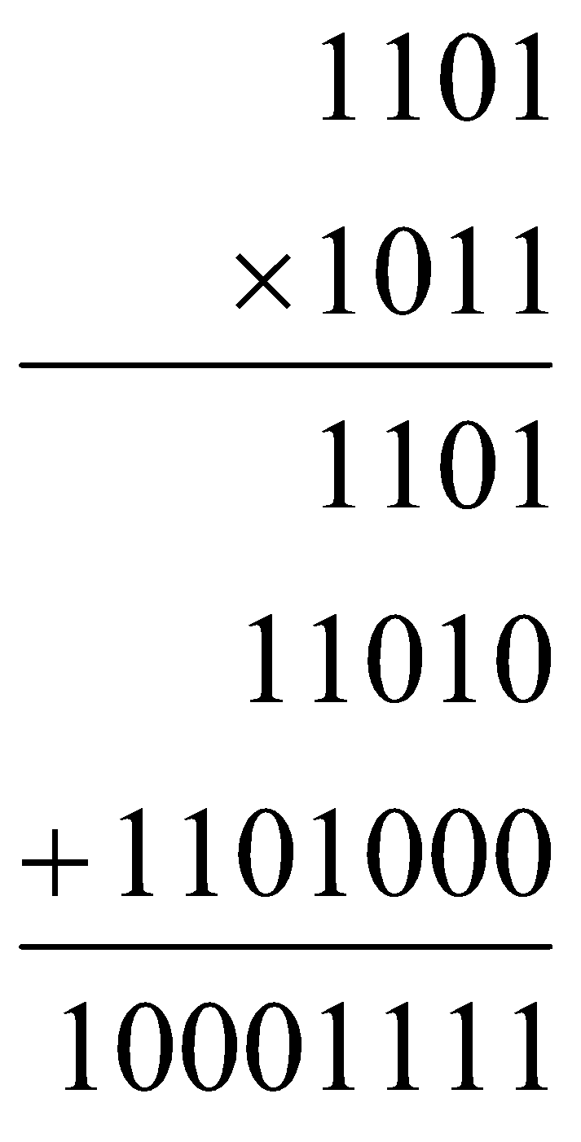
Multiplication (binary)
It’s interesting to note that binary multiplication is a sequence of shifts and adds of the first term (depending on the bits in the second term.
110100 is missing here because the corresponding bit in the second terms is 0.

Slide 88
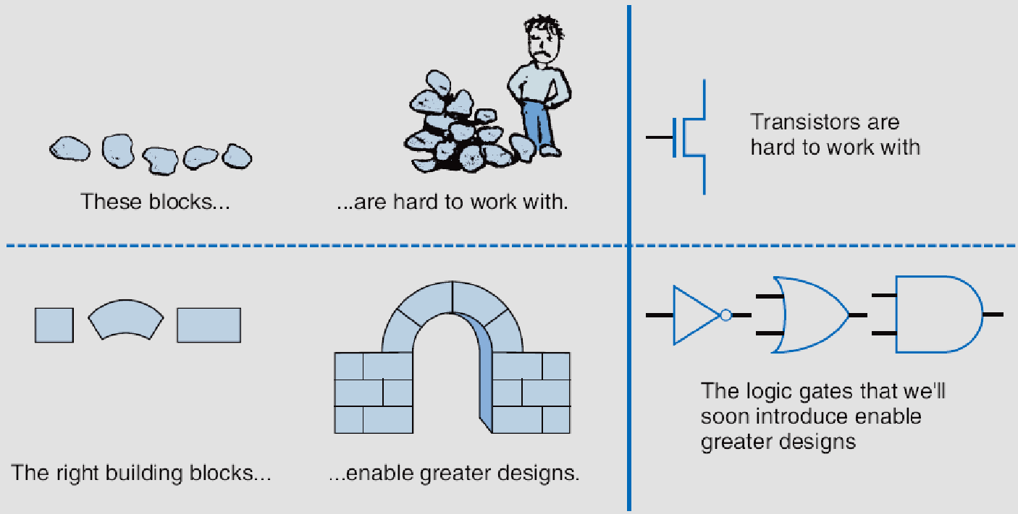
Boolean Logic Gates (Building Blocks for Digital Circuits ) (Because Switches are Hard to Work With)
“Logic gates” are better digital circuit building blocks than switches (transistors), Why?...

Slide 89
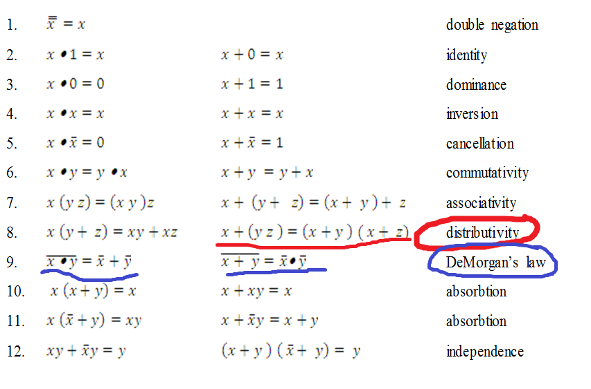
Logic and Boolean algebra

Slide 90


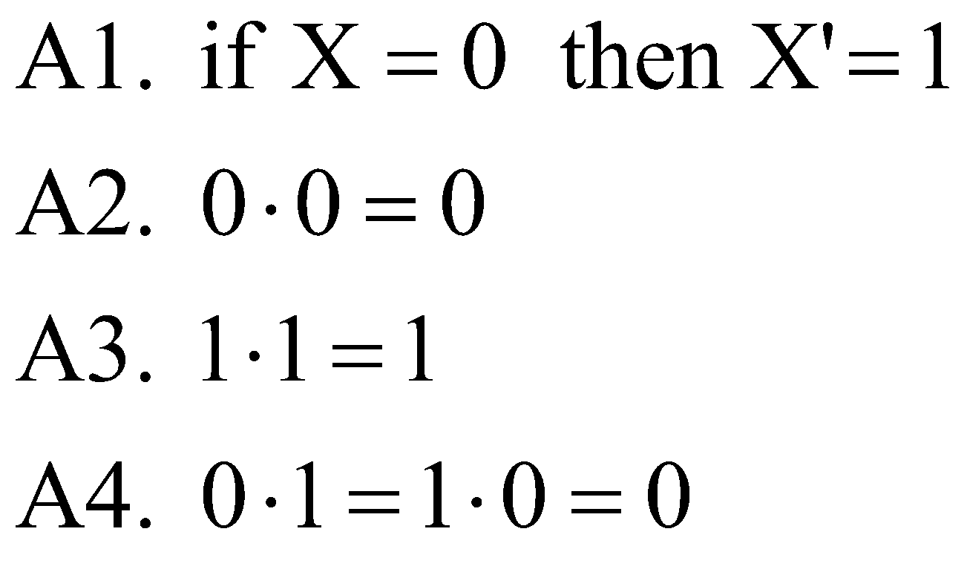
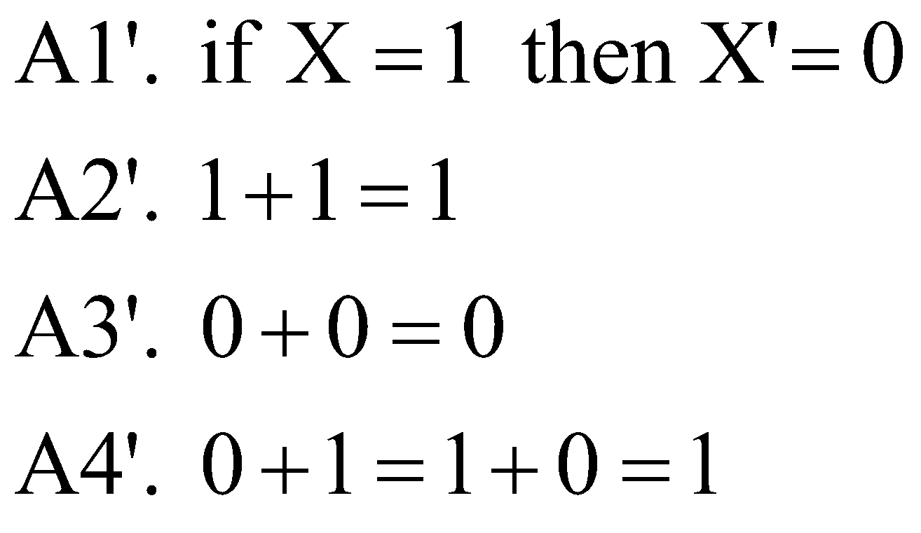

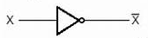


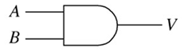
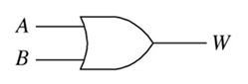
Boolean Algebra Postulates/Rules
Postulates of a mathematical / binary system: Minimal set of basic definitions from which all other information can be derived

Slide 91
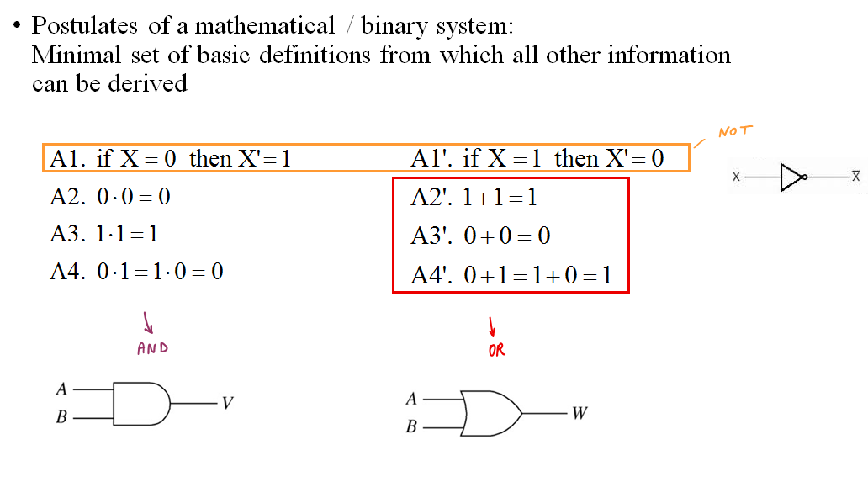
Boolean Algebra Postulates/Rules

Slide 92


Useful Properties of Boolean Algebra
Operations with 0 and 1:
1. X + 0 = X 1D. X • 1 = X
2. X + 1 = 1 2D. X • 0 = 0
Idempotent Theorem:
3. X + X = X 3D. X • X = X
Involution Theorem:
4. (X' )' = X
Theorem of Complementarity:
5. X + X' = 1 5D. X • X' = 0
Idempotent Theorem:
3. X + X = X

Slide 93
Useful Properties of Boolean Algebra
Commutative law:
6. X + Y = Y + X 6D. X • Y = Y • X
Associative law:
7. (X + Y) + Z = X + (Y + Z) 7D. (X Y)Z = X(Y Z) = X Y Z
= X + Y + Z
Distributive law:
8. X(Y + Z) = XY + XZ 8D. X + YZ = (X + Y)(X + Z)
Simplification theorems:
9. XY + XY' = X 9D. (X + Y)(X + Y' ) = X
10. X + XY = X 10D. X(X + Y) = X
11. (X + Y' )Y = XY 11D. XY' + Y = X + Y

Slide 94
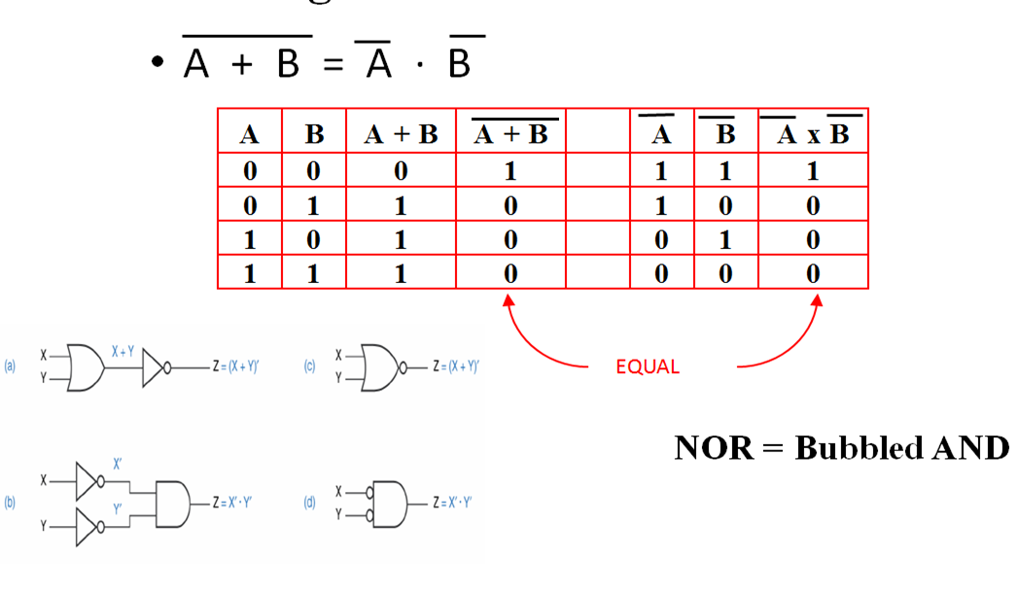
DeMorgan’s Theorem 1

Slide 95
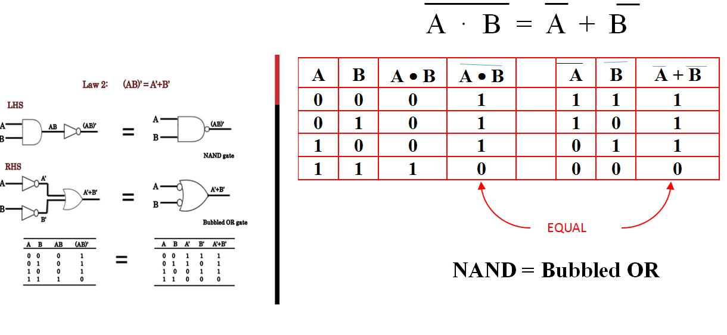
DeMorgan’s Theorem 2

Slide 96
Summary
OR is the same as NAND with complemented inputs
AND is the same as NOR with complemented inputs
NAND is the same as OR with complemented inputs
NOR is the same as AND with complemented inputs

Slide 97


XOR and XNOR gates
XOR
XNOR
X Y Z 0 0 0 0 1 1 1 0 1
1 1 0
X
Y
Z
X⊕Y = X’⋅Y + X⋅Y’
X⊕Y expresses "inequality", "difference" (X ≠ Y)
X Y Z 0 0 1 0 1 0 1 0 0
1 1 1
X
X⊕Y = X⋅Y + X’⋅Y’
Y
Z
X xnor Y expresses "equality", "coincidence" (X ≡ Y)

Slide 98
Exclusive OR Properties
X⊕0 = X
X⊕1 = X’
X⊕X = X
X⊕X’= 0
X⊕Y = Y⊕X (commutative law)
(X⊕Y)⊕Z = X⊕(Y⊕Z) =X⊕Y⊕Z (associative law)
X(Y⊕Z) = XY⊕XZ (distributive law)
(X⊕Y)’ = X⊕Y’ = X’⊕Y = XY + X’Y’

Slide 99
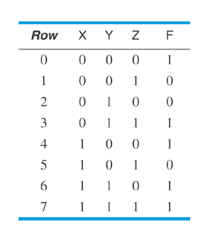






































Representations of Logic Functions
Truth Tables Table that shows the output value for each combination of the inputs. The truth table for an n-variable (n-inputs) logic function has 2^{n} rows.
Algebraic expressions
Karnaugh Maps

Slide 100
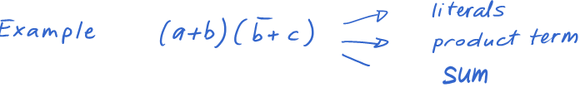
Common Terminology
Literal The appearance of a variable or its complement
Product Term
One or more literals connected by AND operators
Sum Term
One or more literals connected by OR operators

Slide 101
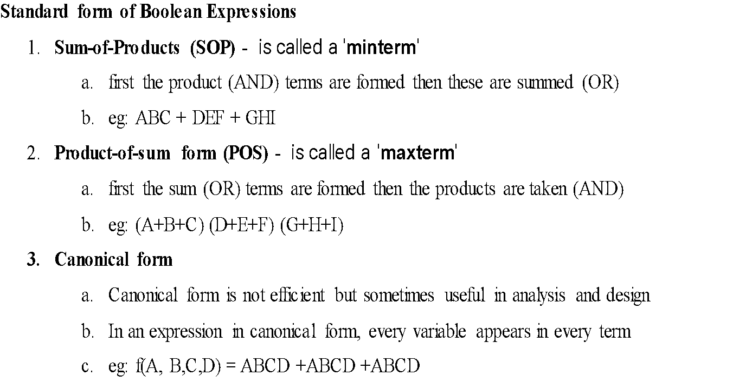
Common Terminology(cnt’d)

Slide 102
SOP & POS

Slide 103
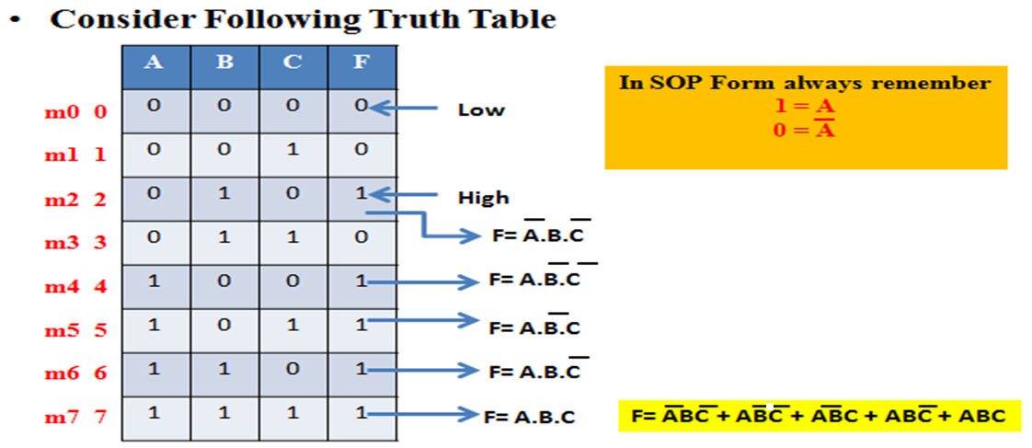
SOP Form Representation

Slide 104
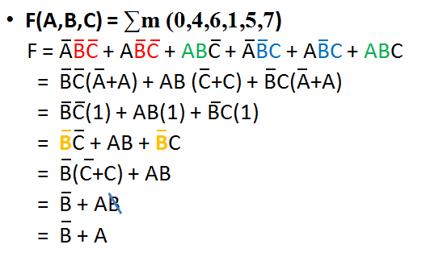
Practice Examples(Contd..) --- Distribution law: X + YZ = (X+Y)(X+Z) ---- In Example ----(B’ + B)(B’+A)

Slide 105
Values of logic variables and logic functions are in binary form( 1 and 0).
Any logic function can be expressed in the forms of
1. Sum of Products form (SOP)
Y= AB + AC’ + BC------------SOP
Product terms: AB, AC’, BC [AND Gate Z = XY ]
Here Summation Terms : 2 terms [OR Gate Z = X + Y ]
ORing of ANDs

Slide 106
Values of logic variables and logic functions are in binary form( 1 and 0).
Any logic function can be expressed in the forms of
2. Product of Sums form (POS)
Y= (A +C)(B + C’)-----------POS
Sum Terms: A+C , B+C’ [OR Gate Z = X + Y ]
Here Product Terms: 1 [AND Gate Z = XY ]
ANDing of ORs

Slide 107
SOP and POS
Canonical Form of Expression and Summation form (SOP) /Product form (POS) of expression

Slide 108
Standard Representations for Logic Functions
Canonical Normal Form
Standard form for Boolean expression that provide a unique signature
If each term in SOP and POS forms contains all the literals then these are known as canonical SOP and POS respectively.
Each individual term in canonical SOP form is called as minterm (mo, m1, m2……)
Each individual term in canonical POS form is called as as maxterm (M0, M1, M2……)

Slide 109
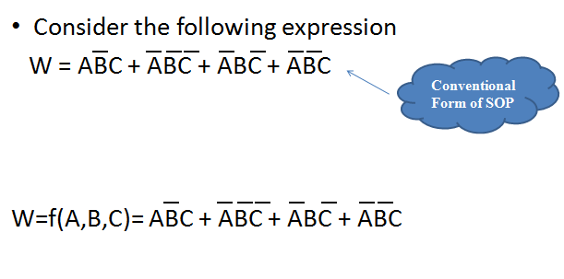
Canonical or Conventional form

Slide 110
Sum of Product (SOP)
It is a Disjunctive Normal form or Minterm Expansion
AB + CD
(A AND B) OR (C AND D)
i.e. OR of AND terms

Slide 111
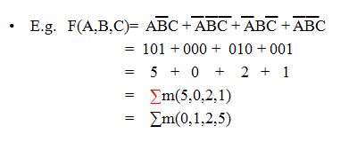
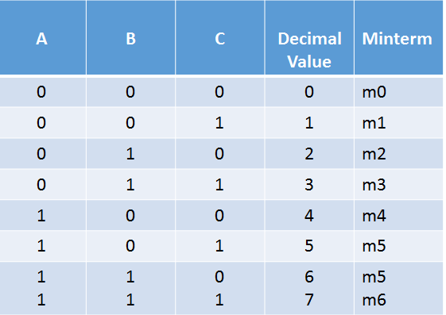
Summation Form of Expression --SOP
In this case we substitute a “1” for all positive variables & a “0” for all inverted
Ex: A = 1 and A’ or A = 0 ; B=1 and B’ = 0 and C=1 and C’ = 0
Canonical Form and Summation form
Minterms

Slide 112
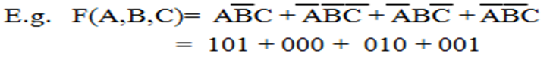
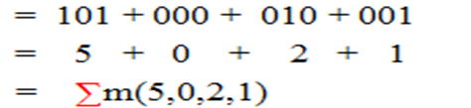
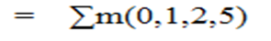
Conversion Process – Canonical form to summation form
It takes 3 steps:
Each minterm is converted into it’s binary equivalent.
2. Each minterm is converted from binary to decimal.
3. Finally the min terms are placed in ascending order

Slide 113
Advantages of Summation form
Useful for implementation in Programmable Logic
Very long & complex expressions can be easily described
Useful for implementation with hardware devices

Slide 114





Practice Examples
= 111 + 110 + 011

Slide 115

Conversion from Conventional to Summation Form

Slide 116



Conversion from Conventional to Summation Form

Slide 117
Conversion from Conventional to Summation Form

Slide 119



Practice Examples(Contd..) {Law of distribution: A+BC = (A+B)(A+C)} so B’ + AB = (B’ +A) (B’ + B) = B’ + A}

Slide 120
Practice Examples(Contd..)

Slide 121

Practice Examples(Contd..) 010, 100, 101, 110, 111

Slide 122
Practice Examples(Contd..) A’X +A = (A+A’)(A+X)= A+X = A + BC’

Slide 123

Practice Examples(Contd..)
CSE203 DIGITAL ELECTRONICS AND LOGIC DESIGN

Slide 124
Practice Examples(Contd..)
m0 = A’B’
m1 = A’B
m2 = AB’
m3 = AB
CSE203 DIGITAL ELECTRONICS AND LOGIC DESIGN

Slide 125
solve
A + A’B + AB ans: A+B
AB’ + A’B + AB + A’B’ ans: 1

Slide 126
Product of Sum (POS)
It is a Conjunctive Normal form or Maxterm Expansion
E.g.
(A+B) (C+D)
(A OR B) AND (C OR D)
i.e. AND of OR terms

Slide 127

POS Contd..
A+B+C
A+B+C’
A+B’+C’

Slide 128

POS (Contd..)

Slide 129

POS (Contd..)

Slide 130

Practice Example

Slide 131
Practice Example

Slide 132

Practice Example (Contd..)

Slide 133
Practice Example (Contd..)
For following truth table find minterm & maxterm i.e. SOP & POS forms
A | B | C | F
0 | 0 | 0 | 1
0 | 0 | 1 | 0
0 | 1 | 0 | 1
0 | 1 | 1 | 1
1 | 0 | 0 | 0
1 | 0 | 1 | 0
1 | 1 | 0 | 1
1 | 1 | 1 | 1
Y (A,B,C) = ∑m(0,2,3,6,7)
m0 0
M1 1
m2 2
Y (A,B,C) = πM(1,4,5)
m3 3
M4 4
M5 5
m6 6
m7 7

Slide 134
Practice Example (Contd..)
For following truth table find summation & product forms i.e. SOP & POS forms
A | B | C | F
0 | 0 | 0 | 1
0 | 0 | 1 | 0
0 | 1 | 0 | 1
0 | 1 | 1 | 1
1 | 0 | 0 | 0
1 | 0 | 1 | 0
1 | 1 | 0 | 1
1 | 1 | 1 | 1
Y (A,B,C) = ∑m(0,2,3,6,7)
m0 0
M1 1
m2 2
Y (A,B,C) = πM(1,4,5)
m3 3
M4 4
M5 5
m6 6
m7 7

Slide 135

Practice Example (Contd..)

Slide 136
Practice Example (Contd..)

Slide 137
Product of Sums form (POS)
Y= (A +C)(B + C’)-----------POS
Sum Terms: A+C , B+C’ [OR Gate Z = X + Y ]
Here Product Terms: 1 [AND Gate Z = XY ]
ANDing of ORs
It is a Conjunctive Normal form or Maxterm Expansion
Example:
(A+B) (C+D)
(A OR B) AND (C OR D)

Slide 138

Practice Example (Contd..)

Slide 139

POS - Maxterms / SOP - Minterms
Truth table describing a digital system/Logic circuit
POS Form:
Y (A,B,C) = π(M0, M1, M3)
Y (A,B,C) = πM(0,1,3)
SOP Form:
Y (A,B,C) = ∑(m2, m4, m5, m6, m7)
Y (A,B,C) = ∑m(2,4,5,6,7)

Slide 140

Practice Example
SOP Representation
Y=∑m(0,2)
SOP FORM
Y = ∑m(0,2)
Y = A’B’ + AB’
Y = B’ ( A’ +A)
Y = B’
B
B’

Slide 141





Practice Example (Contd..)
Y(A,B,C) = πM(1,4,5)
πM(001,100,101)
= (A+B+C’)(A’+B+C)(A’+B+C’)
Consider A’+B = X and C = Y and C’=Z

Slide 142

POS form simplification
X + YZ = (X+Y) (X+Z)
(A+B) (A+B’+C’)

Slide 143
Practice Example (Contd..)
For following truth table find minterm & maxterm i.e. SOP & POS forms
A | B | C | F
0 | 0 | 0 | 1
0 | 0 | 1 | 0
0 | 1 | 0 | 1
0 | 1 | 1 | 1
1 | 0 | 0 | 0
1 | 0 | 1 | 0
1 | 1 | 0 | 1
1 | 1 | 1 | 1
Y (A,B,C) = ∑m(0,2,3,6,7)
m0 0
M1 1
m2 2
Y (A,B,C) = πM(1,4,5)
m3 3
M4 4
M5 5
m6 6
m7 7

Slide 144
Practice Example (Contd..)
For following truth table find summation & product forms i.e. SOP & POS forms
A | B | C | F
0 | 0 | 0 | 1
0 | 0 | 1 | 0
0 | 1 | 0 | 1
0 | 1 | 1 | 1
1 | 0 | 0 | 0
1 | 0 | 1 | 0
1 | 1 | 0 | 1
1 | 1 | 1 | 1
Y (A,B,C) = ∑m(0,2,3,6,7)
m0 0
M1 1
m2 2
Y (A,B,C) = πM(1,4,5)
m3 3
M4 4
M5 5
m6 6
m7 7

Slide 145
Practice Example (Contd..)

Slide 146
Practice Example (Contd..)

Slide 147
Practice Example (Contd..)

Slide 148
Practice Example (Contd..)
Simplify the following expression
Y (A,B,C) = ∑m(0,2,4,6) Ans: Y= C’
Y (A,B) = πM(0,1,2) Ans: Y = AB

Slide 149
Karnaugh Map
K-MAP

Slide 150
Introduction
Expression reduction through basic rules of Boolean algebra is time consuming for higher variables.
Solution is K-Map - graphical method
A Karnaugh map (K-Map) is a pictorial method used to minimize Boolean expression without having to use Boolean algebra theorems & equation manipulation
It is a special version of truth table
Using K-Map, expressions with 2 to 4 variables are easily minimized

Slide 151


2 – Variables K- Map

Slide 152
3 – Variables K- Map
BC
00 01 11 10
A
0
1
0 | 1 | 3 | 2
4 | 5 | 7 | 6
BC
BC
00 01 11 10
00 01 11 10
A
A
0
1
A’B’C’ | A’B’C | A’BC | A’BC’
AB’C’ | AB’C | ABC | ABC’
0
1
A+B+C | A+B+C’ | A+B’+C’ | A+B’+C
A’+B+C | A’+B+C’ | A’+B’+C’ | A’+B’+C
SOP Form
POS Form

Slide 153

4 – Variables K- Map
CD
00 01 11 10
AB
00
01
11
10
0 | 1 | 3 | 2
4 | 5 | 7 | 6
12 | 13 | 15 | 14
8 | 9 | 11 | 10
CD
00 01 11 10
AB
A’B’C’D’ | A’B’C’D | A’B’CD | A’B’CD’
A’BC’D’ | A’BC’D | A’BCD | A’BCD’
ABC’D’ | ABC’D | ABCD | ABCD’
AB’C’D’ | AB’C’D | AB’CD | AB’CD’
A+B+C+D | A+B+C+D’ | A+B+C’+D’ | A+B+C’+D
A+B’+C+D | A+B’+C+D’ | A+B’+C’+D’ | A+B’+C’+D
A’+B’+C+D | A’+B’+C+D’ | A’+B’+C’+D’ | A’+B’+C’+D
A’+B+C+D | A’+B+C+D’ | A’+B+C’+D’ | A’+B+C’+D
00
01
11
10
SOP Form
POS Form

Slide 154


Practice Examples
m0 | m1
m2 | m3

Slide 155



Practice Examples(Contd..)
Way 1
Way 2

Slide 156


Practice example
F = A + BC’
Y=A+BC’

Slide 157

Practice Example
Minterms: 0,2,1
A’
Y = A’ + B’
B’

Slide 158

Example (Contd..)
Minterms: 0,2,6,3,7,5
BC
00
01
11
10
A
0
1 |  | 1 | 1
 | 1 | 1 | 1
1
Z = A’C’ + AC + B

Slide 159
Four Adjacent ones
A’D’
CD
AB
00
01
11
10
00
0 1 | 4 | 12 | 8 1
1 1 | 5 | 13 | 9 1
3 1 | 7 1 | 15 1 | 11 1
2 | 6 | 14 | 10
01
11
AB
10
Y = A’D’ + AB

Slide 160


Practice Example

Slide 161

Example
What is the solution of k map if all entries are 1?. We want SOP form solution.

Slide 162

What is the solution of k map if all entries are 1?. We want SOP form solution.
CD
00 01 11 10
AB
00
01
11
10
0 | 1 | 3 | 2
4 | 5 | 7 | 6
12 | 13 | 15 | 14
8 | 9 | 11 | 10
Y (A,B) = A’B’+ A’B +AB’+ AB
Y = A’(B’+B) + A B’+B)
Y = A’+ A
Y = 1

Slide 163

Folding K map in horizontal direction

Slide 164


Folding K map only in horizontal direction
Folding K map only in Vertical direction

Slide 165

Folding K map in both horizontal as well as vertical direction

Slide 166

Folding K map - AN EXAMPLE

Slide 167

K map for POS form Boolean expressions

Slide 168

POS form – k map simplification

Slide 169

POS form – k map simplification

Slide 170

POS form – k map simplification

Slide 171
Prime Implicant
The process of simplification involves grouping of Minterms & identifying Prime Implicants (PI) & Essential Prime Implicants (EPI)
Prime implicant is a group of ones (minterms) that cannot be combined with any other ones (minterms) or groups
EPI is PI, in which one or more minterms are unique
i.e. it contain atleast one minterm which is not contained in any other PI

Slide 172
Prime Implicant (Contd..)
AB
C
00
01
11
10
0
1
1 |  | 1
1
BA
DC
00
01
11
10
00
 |  | 1 | 1
1 |  |  | 1
 |  | 1 | 1
 |  |  | 1
Prime Implicant
01
11
10

Slide 173
Don’t Care Condition (X)
The K-Maps are simplified using either 1’s or 0’s, therefore we make the entries in the map for either 0 or 1
The cell which do not contain 1 are assumed to contain 0 & vice versa
This is not always true, since there are cases in which certain combinations of I/P variables do not matter

Slide 174
Don’t Care Condition (X)
In such a situation the designer has a flexibility & it is left to him whether to assume 0 or 1 as O/P for each of these combinations
This condition is known as Don’t Care Condition and can be represented on K-Map as a X mark in the corresponding cell
The X mark in a cell may be assumed to be a 1 or 0 depending upon which one leads to a simpler expression

Slide 175

Don’t Care Condition (X)
Without Considering don’t care conditions.
Y= AB’C
Assuming don’t care as 1.
Y=AC

Slide 176

Example

Slide 177

Example

Slide 178

BCD to Excess-3 Code conversion

Slide 179

BCD to Excess-3 Code conversion
E3 = B3 + B2B0 + B2B1

Slide 180

BCD to Excess-3 Code conversion
E2 = B2’B0 + B2’B1 + B2B1’B0’

Slide 181
B1B0 B3B2 | 00 | 01 | 11 | 10
00 | 0 | 0 | 0 | 0
01 | 0 | 1 | 1 | 1
11 | X | X | X | X
10 | 1 | 1 | X | X
B1B0 B3B2 | 00 | 01 | 11 | 10
00 | 0 | 1 | 1 | 1
01 | 1 | 0 | 0 | 0
11 | X | X | X | X
10 | 0 | 1 | X | X
X3 =B3+B2 (B0+B1)
_ _ _ _
X2=B2B1B0 +B2B0 +B2B1
B1B0 B3B2 | 00 | 01 | 11 | 10
00 | 1 | 0 | 1 | 0
01 | 1 | 0 | 1 | 0
11 | X | X | X | X
10 | 1 | 0 | X | X
B1B0 B3B2 | 00 | 01 | 11 | 10
00 | 1 | 0 | 0 | 1
01 | 1 | 0 | 0 | 1
11 | X | X | X | X
10 | 1 | 0 | X | X
_ _
X1= B0B1 +B0B1
_
X0= B0

Slide 182


Change in position of variable (Important to observe)

Slide 183

5 variable Kmap (Not in syllabus)
f(A,B,C,D,E) = Y = ∑m(0,1,3,6,10,11 14, 16,20,25,28,29,31)

